Slide 2
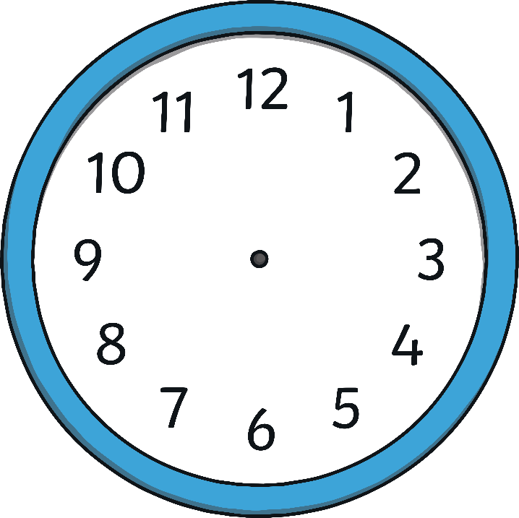
What time is it?
1 o’clock
3 o’clock
4 o’clock

Slide 3
What time is it?
9 o’clock
3 o’clock
8 o’clock

Slide 4
What time is it?
6:15
3:15
6:30

Slide 5
What time is it?
3:15
9:15
3:30

Slide 6
What time is it?
6:15
3:30
6:30

Slide 7
What time is it?
2:50
10:50
10:10

Slide 8
What time is it?
11:40
11:20
8:50

Slide 9
What time is it?
2:10
2:05
1:05

Slide 10
What time is it?
10:10
2:40
1:45

Slide 11
What time is it?
7:15
3:38
3:58

Slide 12
What time is it?
12:12
12:10
2:10

Slide 13
What time is it?
3:18
4:40
8:18

