Slide 1
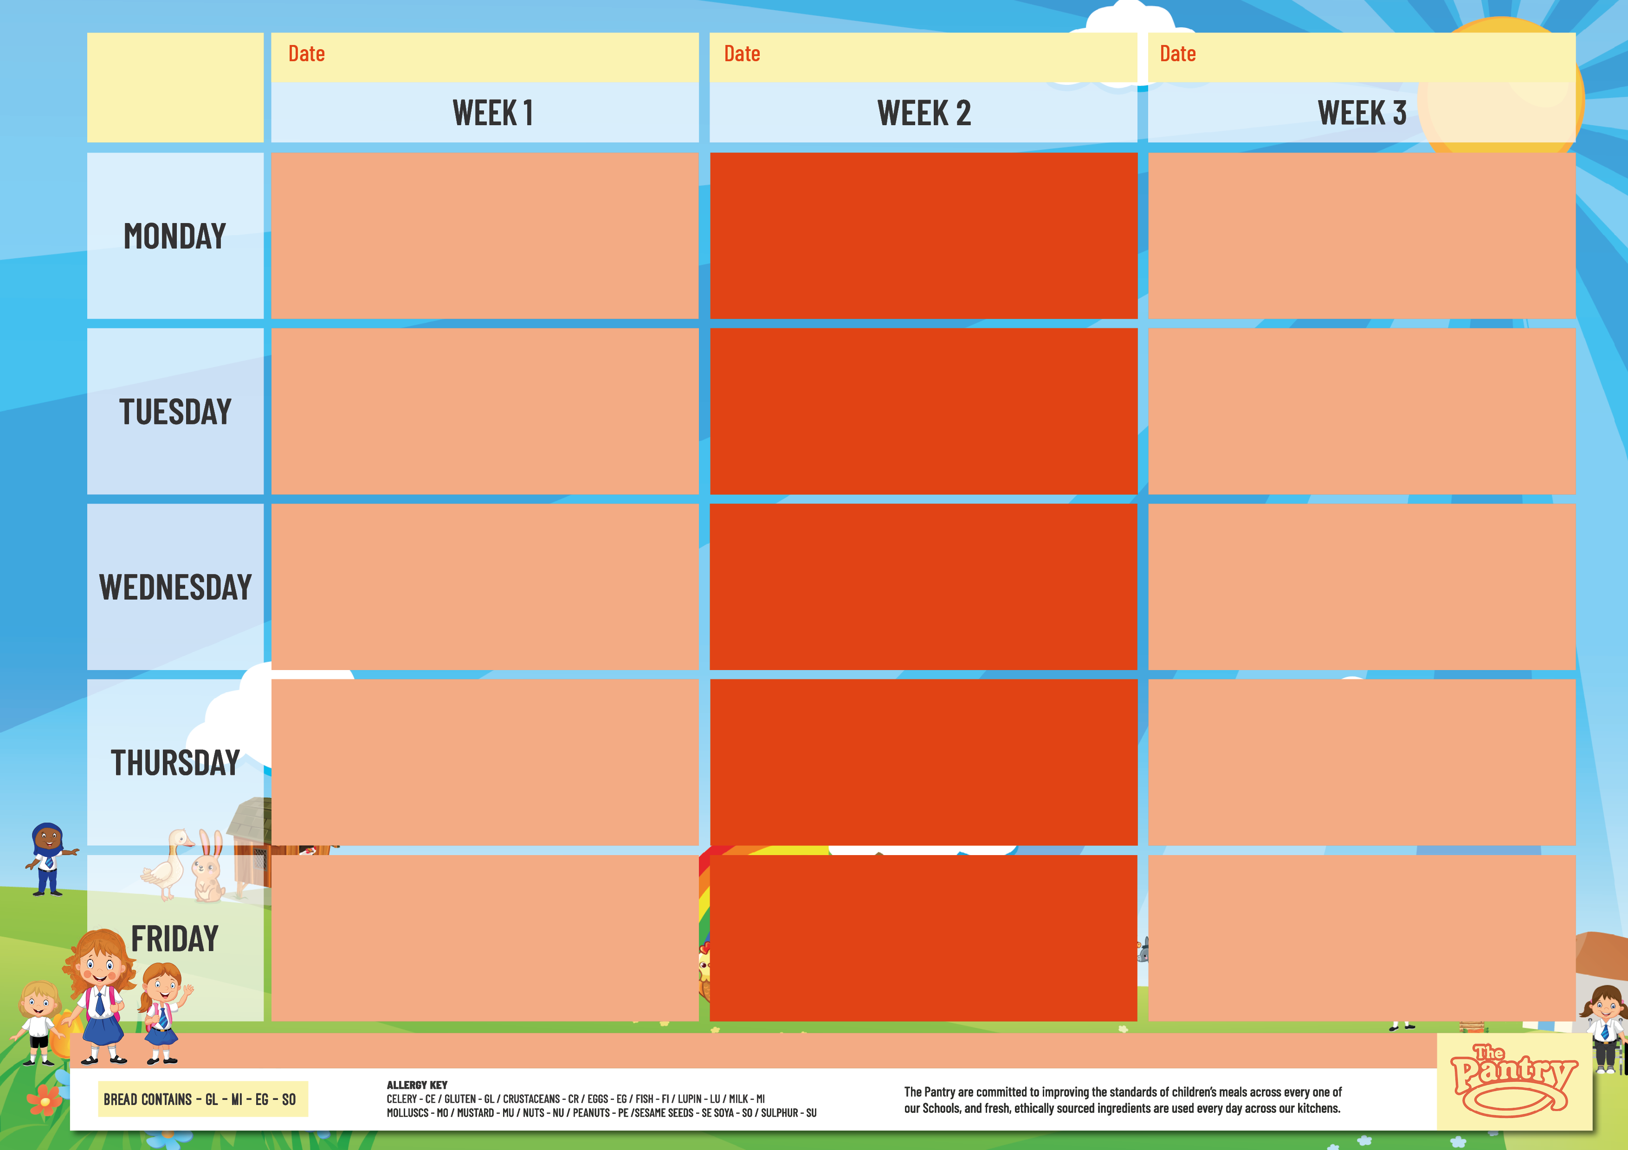
PRIMARYSCHOOL
From the first week of term, and then every three weeks thereafter
From the second week of term, and then every three weeks thereafter
From the third week of term, and then every three weeks thereafter
Beef Lasagne
Sweet Mash Topped Veggie Pie
Tomato Pasta
Jacket Potatoes - Cheese, Beans or Tuna
Ice Cream or Fresh Fruit
Beef Pasta Bolognaise
Veggie Chow Mein Noodles
Tomato Pasta
Jacket Potatoes - Cheese, Beans or Tuna
Cheesecake or Fresh Fruit
Beef Chilli with Rice
Mac ‘n’ Cheese
Tomato Pasta
Jacket Potatoes - Cheese, Beans or Tuna
Ice Cream or Fresh Fruit
Chicken Tikka Masala with Steamed Rice
Pesto Pasta
Tomato Pasta
Jacket Potatoes - Cheese, Beans or Tuna
Cheesecake or Fresh Fruit
Potato Topped Fish Pie
Handmade Margherita Pizza with Slaw
Tomato Pasta
Jacket Potatoes - Cheese, Beans or Tuna
Vegan Fruit Jelly or Fresh Fruit
Pastry Topped Chicken Pie
Handmade Margherita Pizza with Slaw
Tomato Pasta
Jacket Potatoes - Cheese, Beans or Tuna
Cheesecake or Fresh Fruit
Pork Sausage with Mash & Gravy
Vegan Sausage with Mash & Gravy
Tomato Pasta
Jacket Potatoes - Cheese, Beans or Tuna
Vegan Fruit Jelly or Fresh Fruit
Roast Chicken with Potatoes & Gravy
Butternut Wellington
Tomato Pasta
Jacket Potatoes - Cheese, Beans or Tuna
Fruity Shortbread or Fresh Fruit
Roast Turkey with Potatoes & Gravy
Cauliflower Cheese Bake with Potatoes
Tomato Pasta
Jacket Potatoes - Cheese, Beans or Tuna
Vegan Fruit Jelly or Fresh Fruit
Jerk Chicken with Rice
Handmade Margherita Pizza with Slaw
Tomato Pasta
Jacket Potatoes - Cheese, Beans or Tuna
Chocolate Cake or Fresh Fruit
Chicken Fajita with Rice
Veggie Curry with Rice
Tomato Pasta
Jacket Potatoes - Cheese, Beans or Tuna
Apple Cake or Fresh Fruit
Beef Cottage Pie with Mash
Cheese Panini
Tomato Pasta
Jacket Potatoes - Cheese, Beans or Tuna
Iced Confetti Cake or Fresh Fruit
Fish Fingers with Oven Baked Chips
Cheesy Baked Bean Quesadilla with Oven Baked Chips
Tomato Pasta
Jacket Potatoes - Cheese, Beans or Tuna
Dessert Bar or Fresh Fruit
Fish Fingers with Oven Baked Chips
Falafel with Oven Baked Chips
Tomato Pasta
Jacket Potatoes - Cheese, Beans or Tuna
Dessert Bar or Fresh Fruit
Fish Fingers with Oven Baked Chips
Veggie Fajita with Oven Baked Chips
Tomato Pasta
Jacket Potatoes - Cheese, Beans or Tuna
Dessert Bar or Fresh Fruit
VEGETABLES, SALAD, BREAD, AVAILABLE DAILY

