Slide 2

To double a number, we add that number to itself.
For example:
To double 3, we add 3.
3 + 3 = 6

Slide 3

We can also double a number by multiplying it by 2.
For example:
To double 3, we multiply it by 2.
3 × 2 = 6

Slide 4

What is double 4?
8
Remember:
4 + 4 = 8
4 × 2 = 8

Slide 5

What is double 5?
10
Remember:
5 + 5 = 10
5 × 2 = 10

Slide 6

What is double 6?
12
Remember:
6 + 6 = 12
6 × 2 = 12

Slide 7

When we half a number, we divide it by 2.
For example:
To half 4, we divide it by 2.
4 ÷ 2 = 2

Slide 8

What is half of 8?
4
Remember:
8 ÷ 2 = 4

Slide 9
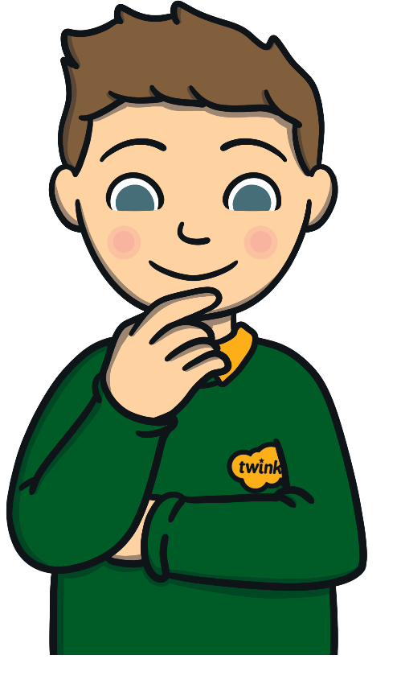
What is half of 12?
6
Remember:
12 ÷ 2 = 6

Slide 10


Doubling is the opposite of halving.
Halving is the opposite of doubling.

