Slide 1



Slide 2

Our Year 1 Team
Mrs Slack – Year 1 Teacher
Mrs Holmes – Teaching Assistant
Mrs Jones – Teaching Assistant
Mrs Westwood – Teaching Assistant

Slide 3
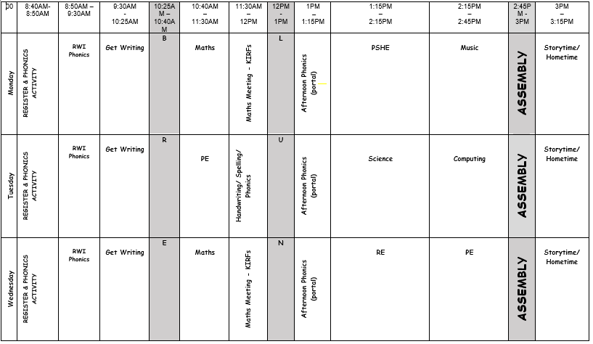
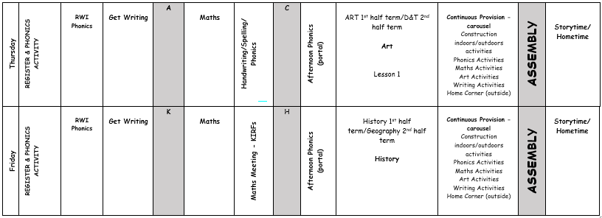
Year 1 Timetable

Slide 4
Year 1 Information
Start time – 8:40am Pick-up time- 3:15pm
A fruit snack is provided every day for our Year 1 children. Alternatively, children may bring their own fruit (no bananas).
Our PE days are Tuesday & Wednesday. Children to come to school in PE kit and bring school uniform to change into afterwards. (Tuesday only)
Please make sure all PE kit and uniform is labelled. Long hair should be tied back and stud earrings removed or covered.
Please ensure that your child brings a named water bottle to school each day and that sun cream is applied before coming to school.

Slide 5
Year 1 Information
Reading books will be changed weekly, on a Friday. Please write in your child’s reading diary when you listen to them read at home. They should be reading to you at home at least three times a week. If your child reads twenty times in a month, they receive a golden ticket!
Please ensure reading books are in school daily so adults can read with children.
They will also be allocated a username and password for Oxford Owl to access the RWI books too. Weekly engagement with the online reading books will also be rewarded with a golden ticket. 1 book per week.
Homework. Reading, KIRFs, letter and number formation.

Slide 6
Year 1 Information
Children in Year 1 now follow the KS1 National Curriculum.
Learning and whole class table work is introduced.
Opportunities for continuous provision are incorporated throughout the week.

Slide 7
Our School Values & Rules
Our school has a strong Christian ethos built on our core Gospel values which the children focus upon each half term:
Endurance, Forgiveness, Thankfulness, Justice, Hope and Compassion.
Our school has three simple rules:
Ready, Respectful, Safe
All classes have a recognition board in their classroom with our school rules of READY, RESPECTFUL, SAFE. Every week there is a different focus for children to aim for and get their names onto the board. This will show that children have gone OVER and ABOVE in school that week. When they do get their names on the recognition board they will be rewarded with a GOLDEN TICKET.

Slide 8
Celebrating Our Work
Writer of the Month
Let Your Light Shine - Thursday
Two children will be chosen as ‘The Star of the Week’. This can be for a wide range of reasons such as:
Having a positive attitude to their learning, resilience, teamwork, following school rules, being a good role model, presentation of work, being a good friend, upholding the school mission statement etc.
One child is chosen for their efforts in writing each month.
Work is displayed in the hall for all to read.
The children are awarded with an age-appropriate reading book of their choice.

Slide 9
Celebrating Our Work
Teachers give children house points to acknowledge outstanding effort or acts of kindness in school.
House points are also given to children for consistent good effort or good work.
Each class has a house point system, where accumulated points are added to the school’s house points. Each child is allocated a house: St Andrew, St George, St Patrick or St David, The house with the most house points for that week is announced in our special assembly.

Slide 10
And Finally…
Please let us know if a different person than usual is collecting your child, even if it is another parent who is known to us.
We are around at the end of the school day for quick queries. If you need to speak to us for a longer meeting, please arrange an appointment with the class teacher in the first instance.
If your child requires an inhaler this should be named and in school.
If you have information to give on your child e.g. allergy, background information then please speak to the Class Teacher.
Please remember that the school is a NUT and BANANA FREE school.
year1@cpa.dsat.education

