Slide 1



Slide 2
OUR Year 3 team
Mrs Rowe – Year 3 teacher
Mrs Jones – Teaching assistant
Mrs Ridgeway – Teaching assistant

Slide 3

Year 3 information
Please ensure all uniform and PE kit is named. There is a Uniform Policy on the school website. All children need to be wearing the correct uniform. This includes PE kit. No jewellery should be worn except for stud earrings. Nail polish should not be worn in school.
Please ensure lunchboxes, snack boxes and water bottles are all named.
Reading books will be changed weekly, on a Thursday. Please write in your child’s reading diary when you listen to them read at home. They should be reading to you at home at least three times a week. If your child reads twenty times in a month, they receive a golden ticket for the school prize draw!
Your child will take home 2 books each week – their reading book and a class library book.

Slide 4
OUR SCHOOL VALUES AND RULES
Our school has a strong Christian ethos built on our core Gospel values which the children focus upon each half term:
Endurance, Forgiveness, Thankfulness, Justice, Hope and Compassion.
Our school has three simple rules:
Ready, Respectful, Safe
All classes have a recognition board in their classroom with our school rules of READY, RESPECTFUL, SAFE. Every week there is a different focus for children to aim for and get their names onto the board. This will show that children have gone OVER and ABOVE in school that week. When they do get their names on the recognition board they will be rewarded with a GOLDEN TICKET.

Slide 5
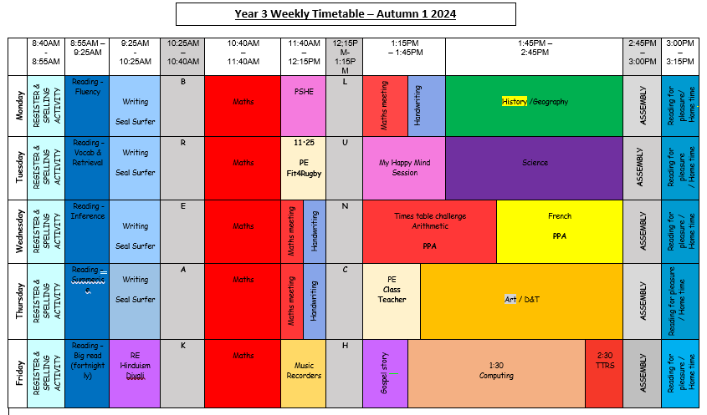

Slide 6
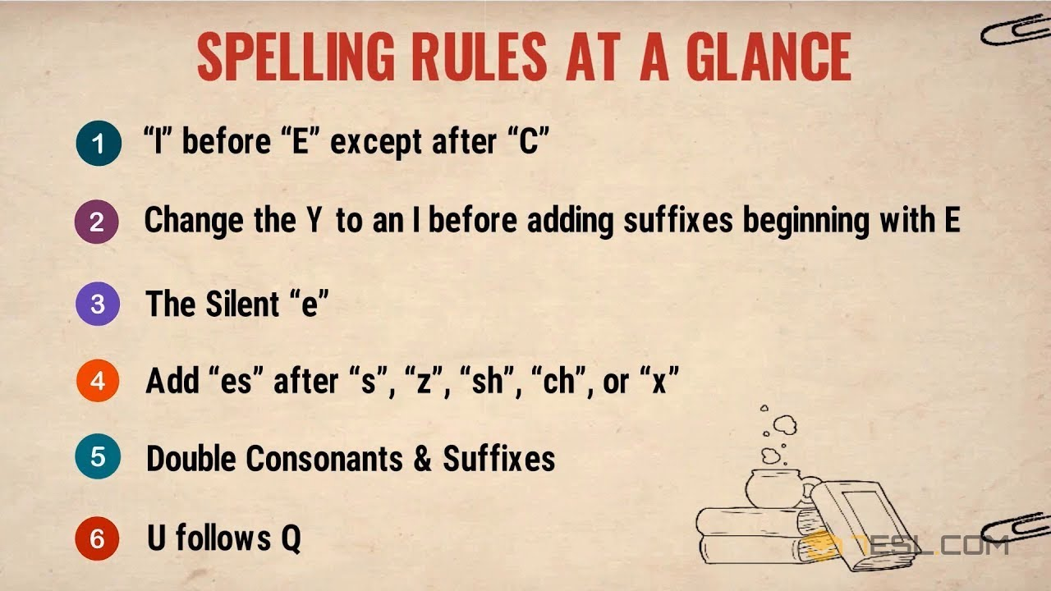

Morning routine
Spelling activities during registration until 8:55am
based on a variety of spelling rules and patterns
Reading alternating weeks of skill based activities and a class focus book unit. During skills based weeks children will focus each day on one of our skills: vocabulary, retrieval, inference, summarise. On the Friday they will be given an unseen text to complete with a range of questions based on the skills previously mentioned; we encourage them to complete these with more independence.
During class book based weeks, children will practice a range of reading strategies including echo, choral, paired and independent reads of a text. They will learn to text mark to help them to read with fluency, intonation and expression and they will answer a range of questions in response to the text they have read.

Slide 7
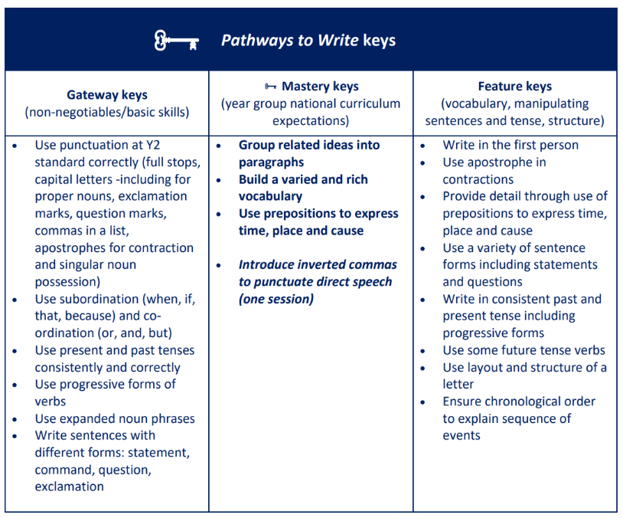

Morning routine continued
Writing – Our current text is based on ‘Seal Surfer’ by Michael Foreman.

Slide 8

Morning routine continued
Maths – This half term we are focusing on securing number knowledge such as number bonds, place value and the worth of different digits within a number.
We are also working on this term’s KIRFs (Key Instant Recall Facts) – a copy of these are on our school website on our Year 3 Class Page for you to practise at home with your children. They have also taken a copy home.
We have also been recapping our Year 2 times tables of 2, 5s and 10s. We have started to learn our 3 times tables which you could also support your child with at home.

Slide 9
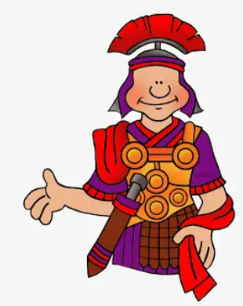
History / Geography
In Year 3, pupils will be learning about the following:
History
The Stone Age and The Romans
Geography
Map skills, Biomes and Villages and Cities

Slide 10
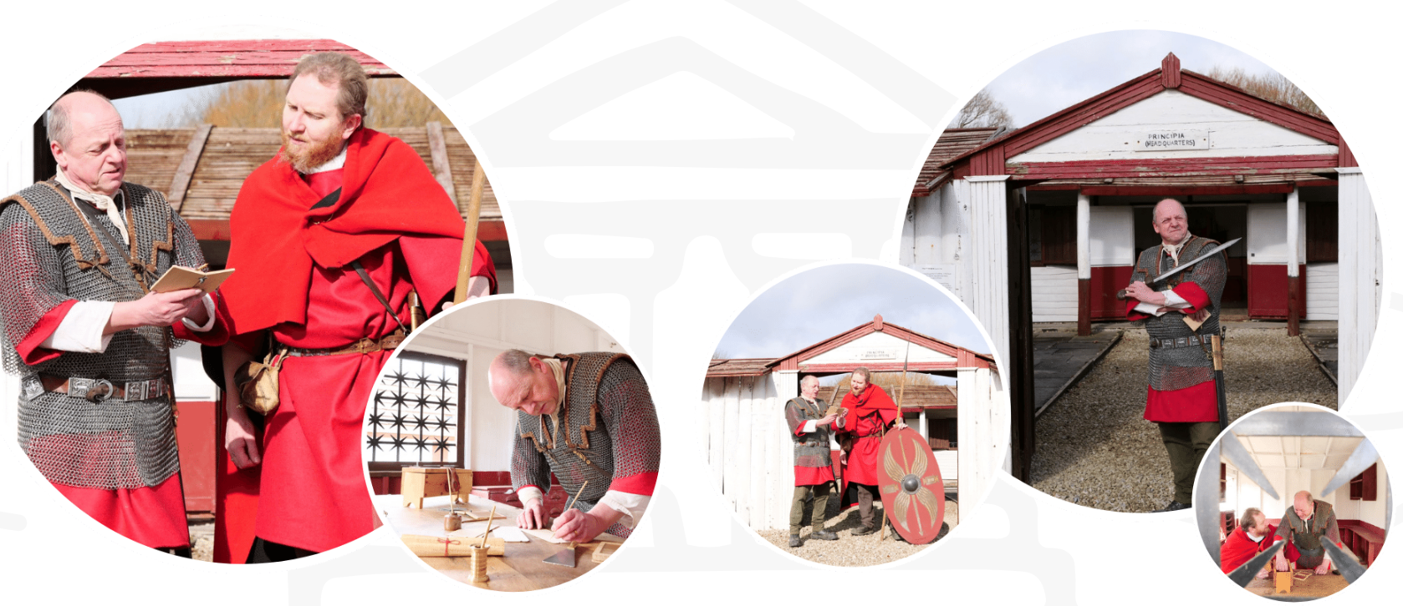
School Experiences/Visits
We are currently in the process of arranging a visit from a to Murton Park when we begin our Romans history topic in the Spring term (January).
The children will spend a full day immersing themselves in the Roman times to learn about Life in the Roman Army. They will be able to dress up, look at replica artefacts and carry out craft activities.
You will receive further information about this in due course.

Slide 11

PE
Year 3’s PE is on a Tuesday morning.
Indoors PE kit
Navy/Black shorts
White polo shirt or t-shirt (N.B. This should be a different polo shirt to any worn as part of the school uniform)
(for gymnastics, a black leotard may also be worn).
Outdoors PE kit
Tracksuits will be allowed for outdoor games in cold weather; these should not be in team colours/fashion brands.
Trainers should be worn which are robust, sturdy and intended for exercise and not fashion. We also have a short additional session on a Thursday to practice skills taught from the main lesson. Please could children either keep their trainers in school all week or bring them for this day as suitable footwear needs to be worn for safety reasons.

Slide 12
Celebrating work
Let Your Light Shine- Thursday
Writer of the Month
One child is chosen for their efforts in writing each week.
Work is displayed in the hall for all to read.
The children are awarded with an age-appropriate reading book of their choice.
Two children will be chosen as ‘The Star of the Week’. This can be for a wide range of reasons such as:
Having a positive attitude to their learning, resilience, teamwork, following school rules, being a good role model, presentation of work, being a good friend, upholding the school mission statement etc
TT Rockstars
Children will receive a certificate when they reach specific goals - presented to them in Thursday’s assembly.

Slide 13
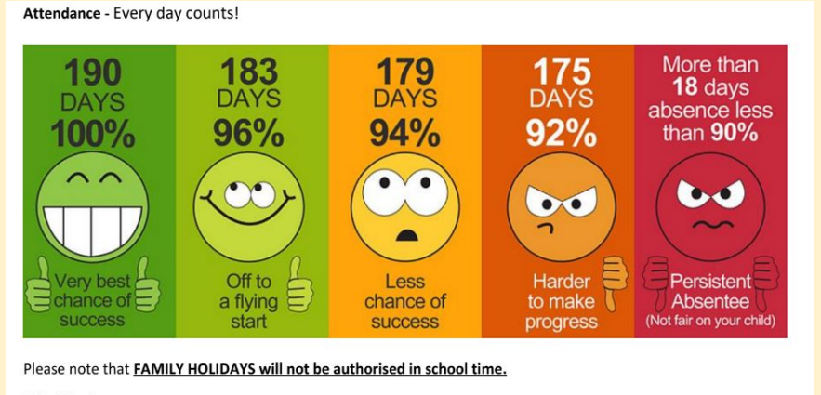
Attendance
Year 3 will receive an extra break time this week for 100% class attendance during the first week of this half term!

Slide 14

Policies and further information
All of our school policies are available to access online
If you ever have any queries or concerns, please do not hesitate to contact us on the playground or via email at:
year3@cpa.dsat.education
Our Year 3 class page has further information about all of the content we will be covering this year too accessible here:
Year 3 - Canon Popham C of E Primary Academy -

