Slide 1
Welcome to
Reception!
Information Presentation for Parents & Carers

Slide 2
Reception staff
Miss Simpkin – Reception Teacher/SENDCo
Miss Oxley – Learning Support Assistant
Mrs Barnes- Lunchtime Supervisor

Slide 3
Transition
Transition Pack
Home visits for new starters –Monday 8th July (Morning)
Transition days – Monday 8^{th (afternoon)}-Friday 15th July
Start date – Tuesday 3rd September 2024
Transition page on our school website

Slide 4
Transition Pack
Welcome to Reception Information booklet
Forms to complete and return to school by Friday 5th July
Information on how to prepare your child for Reception
All about me bunting- complete and bring along to transition days
Cool milk information flyer – please register before your child starts Reception – will need to pay once your child has turned 5.
Tapestry

Slide 5
What will your child need to bring to School?
Named Water bottle with sports cap – water only
Named Book bag – ordered through school trends. We have a very small area for bags!
Medicines – inhalers and prescribed medicines only

Slide 6
Uniform
Uniform is compulsory in Reception
Grey trousers, skirts or pinafore dresses
White or pale blue polo shirt
Royal blue sweatshirt, jumper or cardigan
PE Kit- white t-shirt & black shorts
Please name everything, even shoes!

Slide 7
Lunchtime
School lunches are free for Reception children and KS1
Order via Lunch hound
Packed lunches – need to be healthy and nutritionally balanced. No chocolate, sweets, bananas.

Slide 8
Preparing for Reception
Promoting independence-putting coat on, trying to zip it up, taking jumpers on/off, hanging things up​
Communicating their needs- try to encourage your child to speak to you about what they want and need, repeat back to them in full sentences for them to copy​
Dinner time- using a knife and fork, open packets in packed lunches​
Using the toilet and washing hands ​
Writing their name​
Counting and recognising numbers in the environment

Slide 9
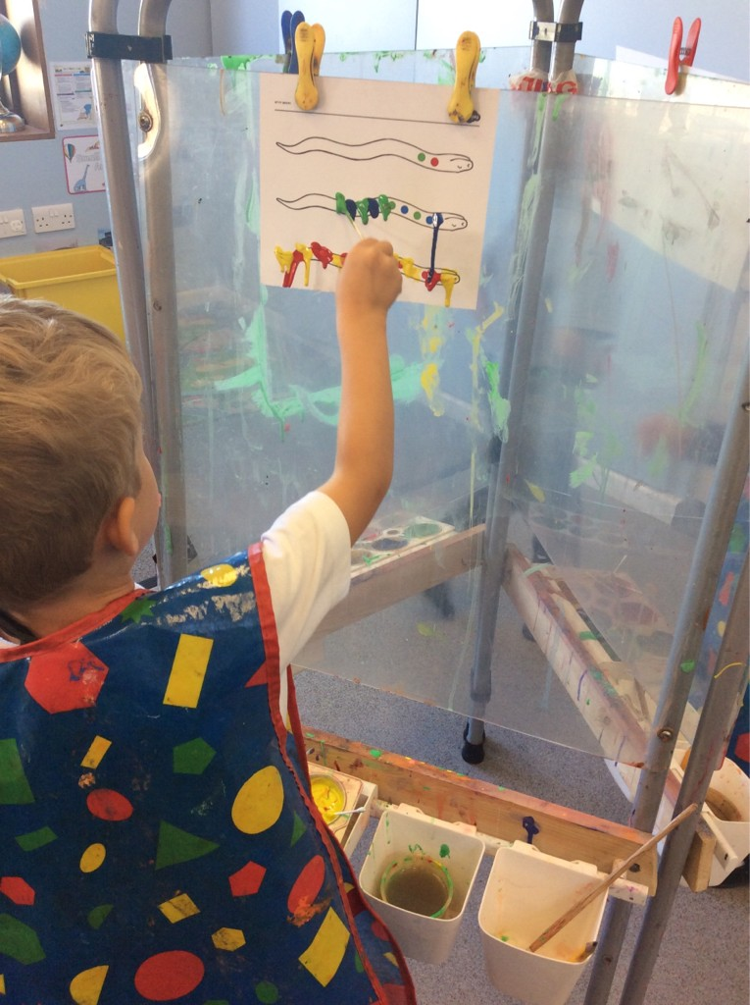
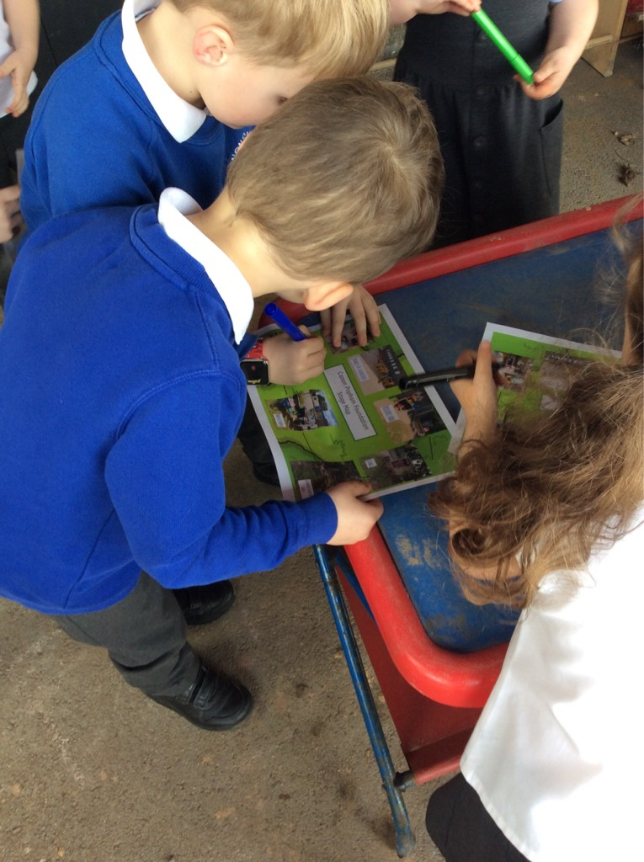
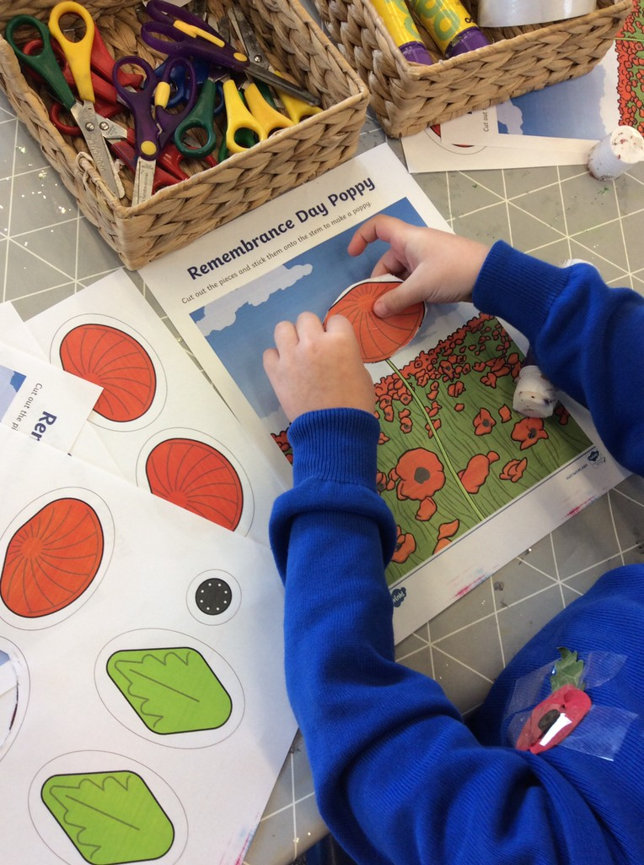
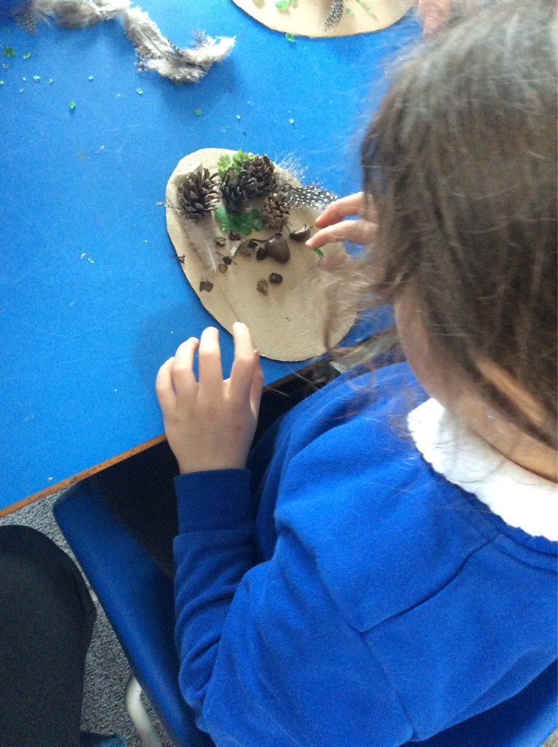
Our Curriculum
Phonics, English and small group writing task​
Playtime
Maths and small group maths-based task​
Dinner time​
Curriculum input- foundations of history, geography, science, art etc. Linked to current theme and children's interests​
Outdoor provision​
Worship time/assembly​
Home time ​
Balance of independent play and adult directed learning

Slide 10

Assessment
Reception Baseline Assessment (RBA)- every Reception child in England will do this​
Using Tapestry and observing our children in their learning​
Challenges sent home on Tapestry- parent contributions through this and home reading​
Extending learning through play and small group/whole class learning ​

Slide 11
Questions
If you have any questions or concerns please phone us on 01302 884465 or email at foundationstage@cpa.dsat.education

