Slide 1



Slide 2
Our Year 2 team
Mrs Rowe – Year 2 teacher
Mrs Barnes – Teaching assistant

Slide 3
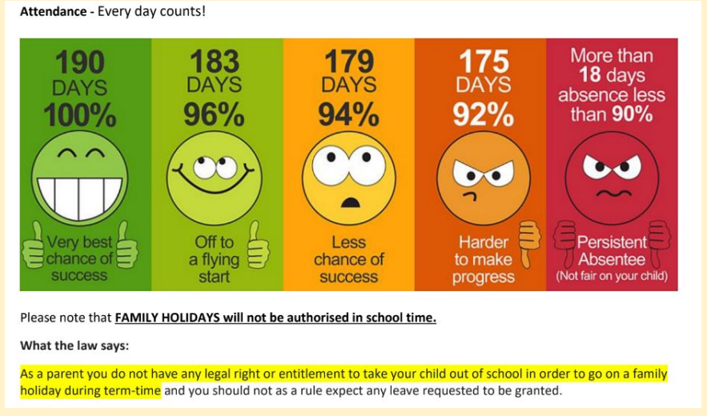
Attendance

Slide 4
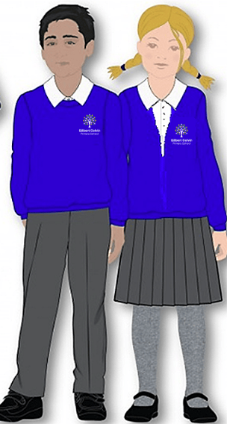

Year 2 information - Uniform
We have a Winter and a Summer uniform option for children to wear. There is a Uniform Policy on the school website. All children need to be wearing the correct uniform. This includes PE kit.
No jewellery should be worn except for stud earrings. Nail polish should not be worn in school.
Please ensure all uniform and PE kit is named.

Slide 5
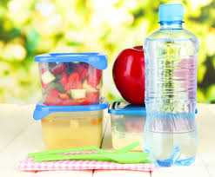
Year 2 information - Snack
.A healthy snack is provided daily for year 2 children, however you may provide your own such as a piece of fruit or a cereal bar.
Please remember that our school is a BANANA and NUT FREE school.
Water bottles should contain water only as we are a healthy school.
Please ensure lunchboxes, snack boxes and water bottles are all named.

Slide 6
Our School Values and Rules
Our school has a strong Christian ethos built on our core Gospel values which the children focus upon each half term:
Endurance, Forgiveness, Thankfulness, Justice, Hope and Compassion.
Our school has three simple rules:
Ready, Respectful, Safe
All classes have a recognition board in their classroom with our school rules of READY, RESPECTFUL, SAFE. Every week there is a different focus for children to aim for and get their names onto the board. This will show that children have gone OVER and ABOVE in school that week. When they do get their names on the recognition board they will be rewarded with a GOLDEN TICKET.

Slide 7
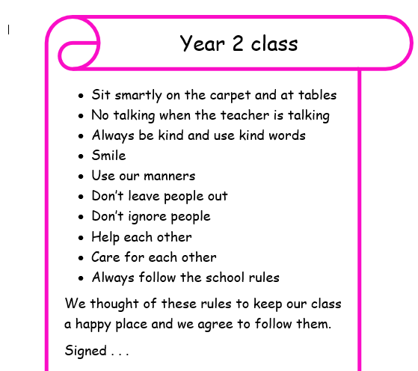
Our Class Charter

Slide 8

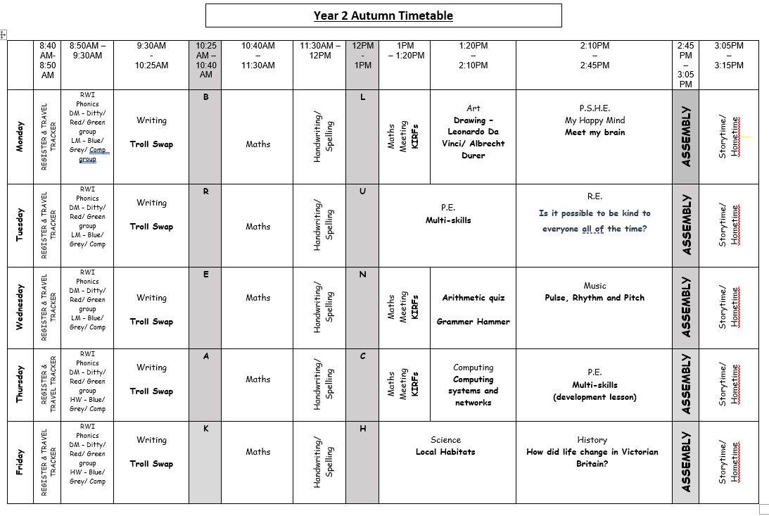
Year 2 information - Class timetable

Slide 9

Year 2 information - curriculum
All information about our curriculum can be found on our Year 2 webpage. Click on the link to access.
www.canonpopham.co.uk/curriculum/our-class-pages-and-curriculum-planning/year-2

Slide 10

Year 2 information - PE
PE is on Tuesday afternoons Children should arrive in the morning in their school uniform and after lunch they will change into their P.E. kit. All P.E. kit should be labelled. Long hair should be tied back and stud earrings removed or covered with tape or plasters provided from home.
Please note Year 2 will have an additional session on Thursday afternoons for the Autumn term only (Christmas half term)

Slide 11


Year 2 information - Reading
Reading books will be changed weekly, on a Friday. Please write in your child’s reading diary when you listen to them read at home. They should be reading to you at home at least three times a week. If your child reads twenty times in a month, they receive a GOLDEN TICKET!
Your child will take home 2 books each week – their reading book and a class library book. They have also been allocated a username and password for Oxford Owl to access the RWI books too. Weekly engagement with the online reading books will also be rewarded with a GOLDEN TICKET.

Slide 12

Year 2 information - Maths
NUMBOTs
NumBots is an on-line programme to boost addition and subtraction skills. It is available on a range of devices, you can play online at Numbots Game or download the Numbots app. For further details please see the year 2 class webpage. Children will receive a golden ticket for accessing their Numbots for 15minutes or more each week.
Your child will have a log-in and password to enable them to access NUMBOTs to improve their arithmetic fluency skills. Weekly engagement with NUMBOTs will also be rewarded with a GOLDEN TICKET.

Slide 13

Year 2 information – Maths
KIRFs
Each half term we will focus on knowing and remembering our Key Instant Recall Facts (KIRFs). More information about our school KIRFs can be found here Our Maths Page. A print out will be sent home each half term and an electronic link is available on our class webpage. Please help your child to practice these little and often.
Arithmetic
Once we feel children are settled and ready we will begin to send home a weekly arithmetic activity to enable children to further practice and consolidate these important skills and build their fluency.

Slide 14

Year 2 information – Spellings
Head-Start
Alongside our Read Write Inc approach, children will be following the Head-Start spelling programme this year, with a dedicated spelling lesson each day. Each term a copy of the spellings we will be covering will be sent home and a link added to our class webpage.
We will be beginning term 1, week 1 on Monday 8th September 2025. Please use the termly sheet as a guide to see where we are and to help your child to remember the spelling patterns covered.

Slide 15

Celebrating work
Reader of the Month
One child is chosen from all the golden readers that month.
Their name is displayed in the hall for all to see.
The children are awarded with an age-appropriate reading book of their choice.
Writer of the Month
One child is chosen for their efforts in writing each half term.
Work is displayed in the hall for all to read.
The children are awarded with an age-appropriate reading book of their choice.
Let Your Light Shine assembly
Two children will be chosen for a wide range of reasons such as:
Having a positive attitude to their learning, resilience, teamwork, following school rules, being a good role model, presentation of work, being a good friend, upholding the school’s vision statement etc
NUMBOTs
Children will receive a certificate when they reach specific levels presented to them in our Let Your Light Shine assemblies.

Slide 16
Celebrating work
Homework
Children will receive 2 house points for returning completed homework on time.
Times Table Challenge
Children will receive a certificate when they reach the next level. This is presented to them in our Let Your Light Shine assemblies.
House Points
Each class has a house point system, where accumulated points are added to the school’s house points. Each child is allocated a house: St Andrew, St George, St Patrick or St David.
Teachers give children house points to acknowledge outstanding effort or acts of kindness in school.
House points are given to children also for consistent good effort or good work.
The house with the most house points for that week is announced in Let Your Light Shine assembly.

Slide 17

• We are around at the beginning and end of the school day for quick queries. If you need to speak to us for a longer meeting, please arrange an appointment with the class teacher in the first instance.
If your child requires an inhaler this should be named and in school with a care plan.
Any information regarding your child e.g. appointments, short term medication, a different person than usual is collecting your child, even if it is another parent who is known to us etc then please speak to myself or any of our additional adults. Alternatively you could email the address below:
Our class email: year2@cpa.dsat.education

